Slide 1
Predicting Stock Market
This presentation aims to explore the use of LSTM models in predicting stock prices to aid investors and traders in making better-informed investment decisions.
GROUP-11
VAMSHITHA KOMPELLY
LIKITHA VADLA

Slide 2
Stock prediction is important for several reasons:
Making informed investment decisions based on future price movements.
1
Supporting companies in financial planning and budgeting.
2
Identifying potential risks and implementing risk management strategies.
3

Slide 3
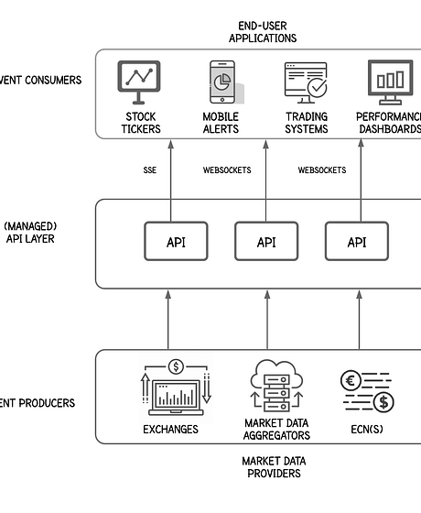
Data Sources
Advantages of yfinance Library
Provides a simple and convenient interface for downloading historical data from Yahoo Finance.
Retrieves high-quality data including stock prices, dividends, and financial statements.
Offers high customizability in terms of data parameters and format.

Slide 4
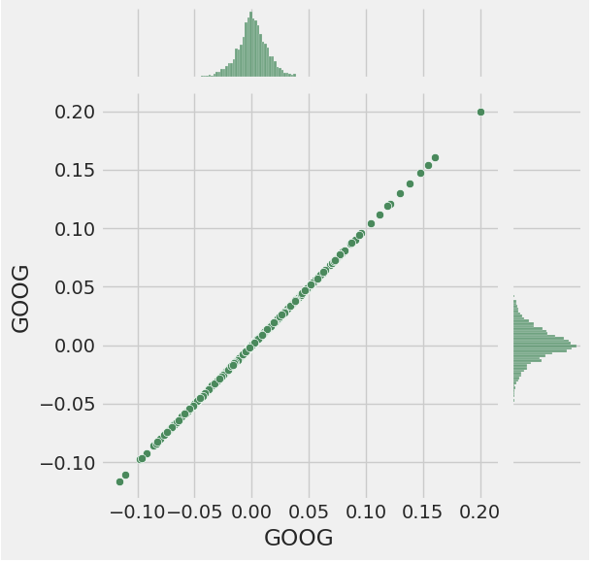
Feature Engineering
Utilize correlation analysis to understand the relationship between different features and the target variable.
Apply feature importance scores from tree-based models to identify the most important features for prediction.
Used domain knowledge to handpick relevant features that align with the economic principles.
Implement principal component analysis (PCA) to reduce the dimensionality of the feature space while retaining critical information.
Evaluate and select the most appropriate feature selection technique based on the data characteristics and prediction requirements.

Slide 5

Model Selection
Support Vector Machine (SVM)
SVM is a powerful machine learning algorithm used for classification and regression.
The SVM model is used for stock price classification, predicting price increase or decrease.
SVM works by mapping data to a high-dimensional feature space so that data points can be categorized, even when the data is not linearly separable.
The scikit-learn library's SVM implementation was used, scikit-learn is a widely used open-source ML library in Python.

Slide 6
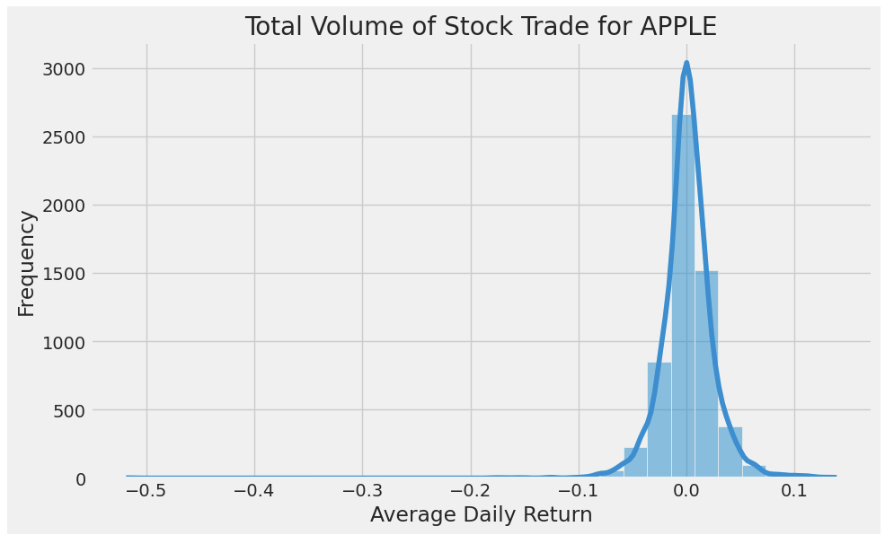
Model Evaluation
Evaluation Metrics
The accuracy score is currently used to evaluate the SVM model, calculated as the average of the scores obtained on each fold.
Precision, recall, and F1 score are mentioned as alternative evaluation metrics.
These metrics assess the performance of classification models in terms of true positive/negative and false positive/negative predictions.

Slide 7


Deployment
After finalizing the model, a RESTful API or web service was created using a suitable framework like Flask.
The purpose of this API is to serve as the interface between the users and the LSTM model, allowing users to send requests to the model and receive predictions back.
Once the API was created, it will need to be deployed on a cloud platform such as AWS to ensure accessibility and scalability.

Slide 8
DEMO

Slide 9
Conclusion
Distributed machine learning can help us make better predictions in the stock market by leveraging the power of parallel computing.
Our approach demonstrated how we can use technical indicators and lagged features to improve the prediction performance in a distributed environment.
The results showed that distributed gradient boosting outperformed other models in predicting stock prices for AAPL.
However, the prediction accuracy is subject to various factors, and investors should use caution when making investment decisions based on machine learning predictions.

Slide 10
Resources
Github link :https://github.com/Vamshitha211/DSCI-6007-01-GROUP-13
Python notebook: https://colab.research.google.com/drive/1MWrzg5yY1B5guLK0VthcZAN1NqNE0lRr?usp=sharing#scrollTo=ujm5Oq9vz_KM

Slide 11

Thank you 😄

